Slide 1
Review Support Model

Slide 2
Agenda
SDT Support Activities
Ticketing Process
  Incident Management
  Problem Management
Support through Other teams
  Siebel
  Click Software
Known Issues
Engagement Roadmap
Multi-tier Support model
Operational Excellence check

Slide 3









SDT Support Activities Overview
FSE
CALL CENTER AGENT
SERVICENOW
HOSPITAL/SITE
SUPPORT TEAM

Slide 4
Ticketing Process - Roles & Flow
END USER
Create incident record through web forms
View incident records
CG Support Team
Create incidents through the web form or incident form in service Now.
Access the incident and Problem management core functions.
Assigned to work on incident or problem ticket.
New
Active
Pending
Resolved
Closed

Slide 5
Incident Management
 | New | Active | Awaiting Info | Awaiting Evidence | Awaiting 3rd party | Resolved | Closed
End User/ Help Desk
CG Team
Notifications | Notification to caller Notification to incident assigned group Notification to incident assigned person |  | Incident awaiting user info |  |  | Incident resolved (notification to caller) | Incident closed Incident Survey (notification to caller)
Need more info
Re-open incident
Awaiting User Info
Awaiting User Evidence
Need more
info
User updated info
User updated info
Resolved
Close incident
New incident
Active
Need more info
Awaiting 3rd party
Resolve
incident
Re-open Incident

Slide 6
Ticketing Process – Roles and Flow
END USER
Create record through web forms
View records
CG Support Team
Create through the web form or incident form in service now
Access the Problem management core functions
GEHC Team
Reviewers
Approvers
Problem known error
Open
Pending RCA
Known Error/ Pending CA
Pending Change
Closed/Resolved
Cancelled/Invalid

Slide 7
Problem Management Workflow
 | Open | Pending RCA | Known Error/Pending RCA | Pending Change | Closed as Known Error | Cancelled/ Invalid | Closed
ITIL/ Help Desk
CG Team
GEHC
Notifications | Notification to caller Notification to problem assigned group Notification to Problem assigned to person | RCA Person Approval: Notification to RCA approval person | CA Person Approval: Notification to CA approval person |  |  |  | Problem Closed : Notification to caller
New Problem
Create
Change
Known
Error
Pending RCA
(Root Cause Analysis)
Known Error/Pending CA
(Corrective Action)
Pending Change
Closed as Known Error
Cancelled /Invalid
Send to RCA
Open(Assigned Person working on problem)
Closed
Closed
Closed
Cancelled
Close problem
RCA
Rejected
CA
Approval
RCA
Approval
CA
Rejected
CA
Approved
RCA
Approved
Resolve Problem
RCA Approver
CA Approver

Slide 8
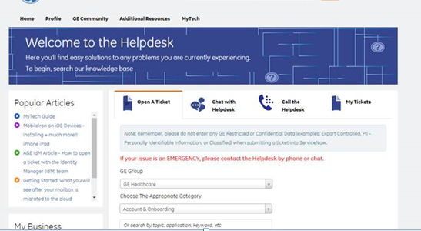
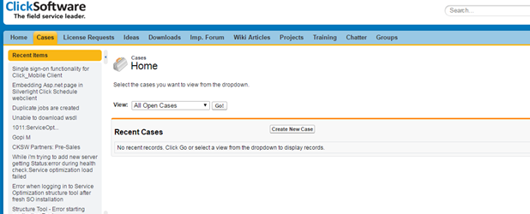
Support through other teams
Siebel – ServiceNow
https://ge.service-now.com/Helpdesk/
htthttps://ge./
ClickSoftware – Support tool
https://cksw.force.com/support/

Slide 9
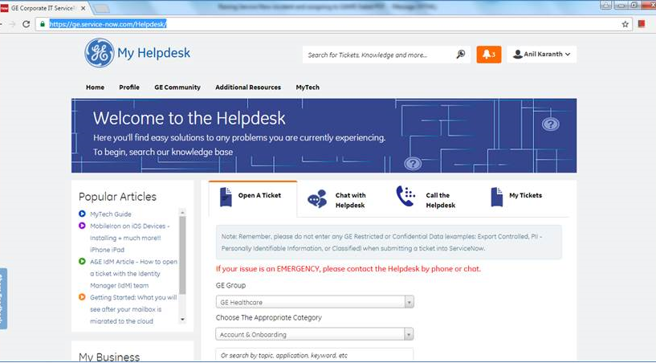
Siebel Team Support
Go to https://ge.service-now.com/Helpdesk/

Slide 10
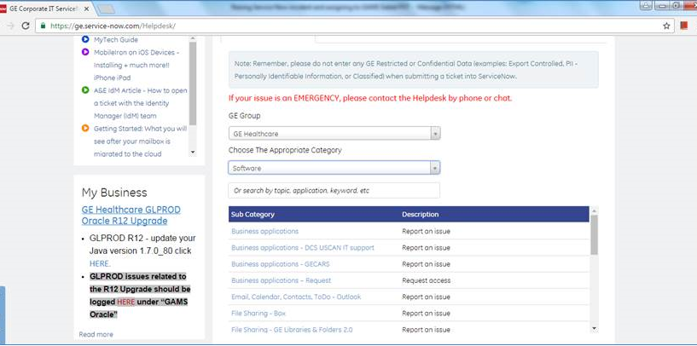
Siebel Team Support
Choose Category as Software and select Sub category as Business applications

Slide 11
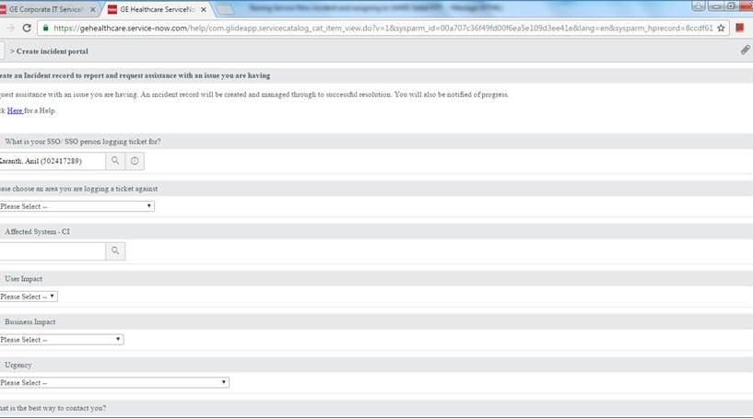
Siebel Team Support
A new form will open

Slide 12
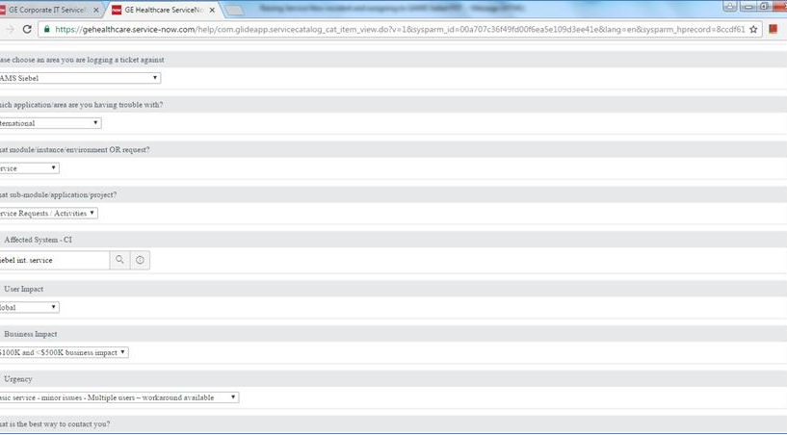


Siebel Team Support
Select the details as per the below snapshot

Slide 13
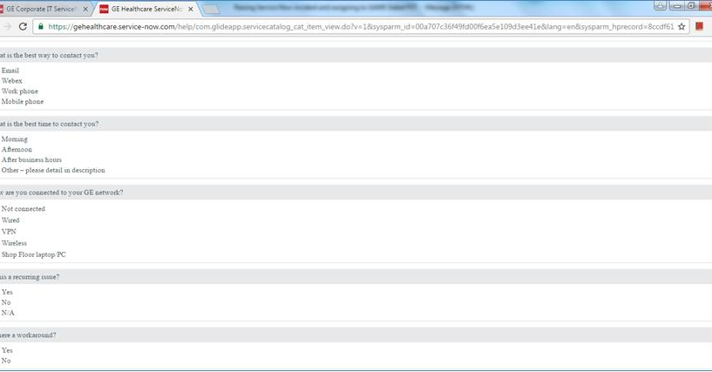
Siebel Team Support

Slide 14
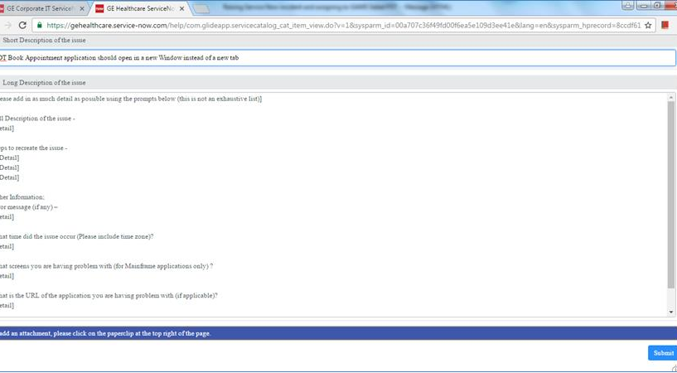


Siebel Team Support

Slide 15
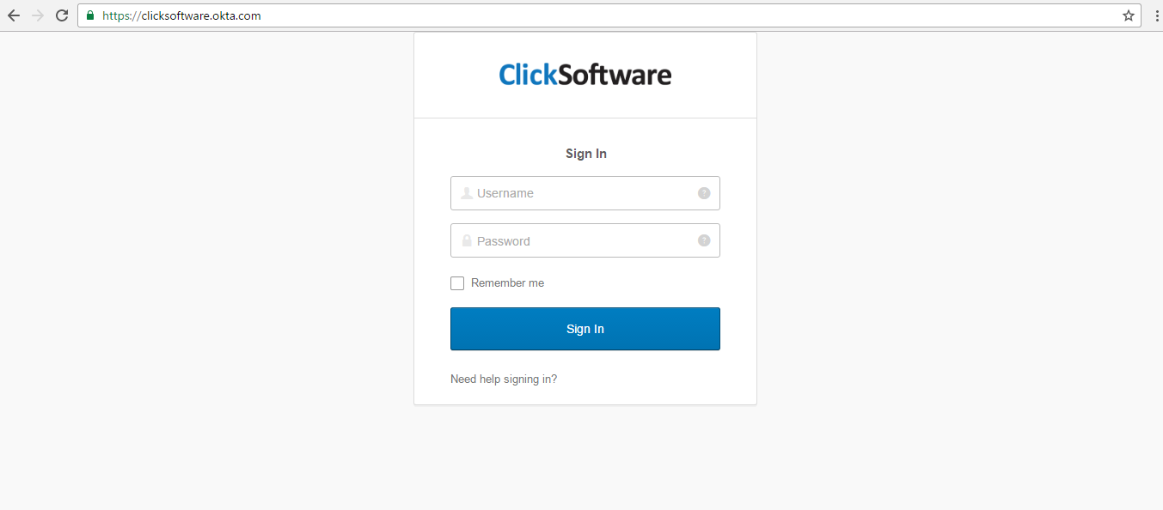
Click Team support
Login Page of Click support portal

Slide 16
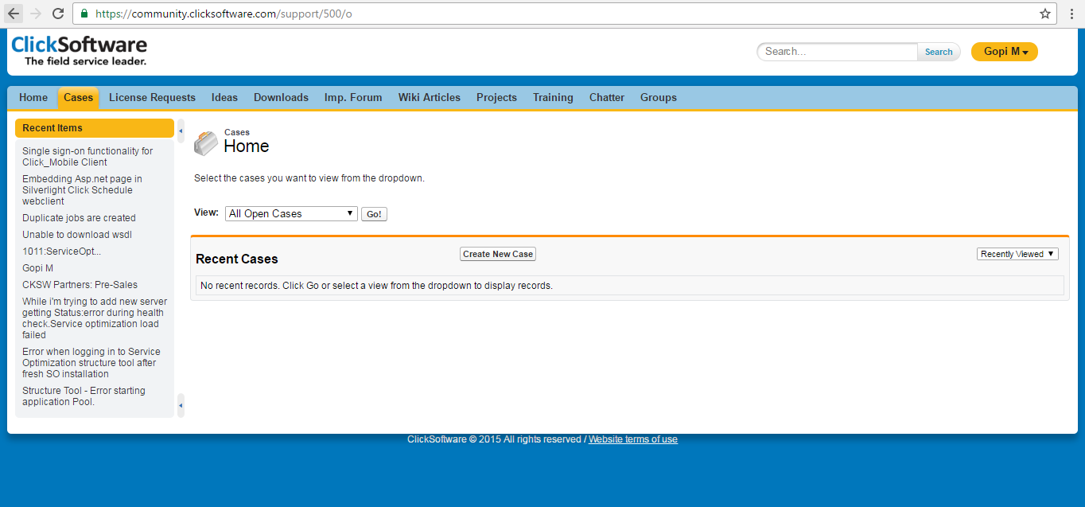
Click Team support
Raising new cases

Slide 17
Known Issues
Site location address is not getting populated properly in the first attempt. User is unable to get correct address on google map for the first time
An error message gets displayed upon launching SDT application from Seibel application
Duration selected in the Siebel page option is not getting reflected in SDT booking page
Site/System IDs are not configured/sync in Seibel or SDT application. Mismatch in the Site-System association

Slide 18
Engagement Roadmap
Transition
Steady State Services
Planning
Program
Kick-Off
and
Due Diligence
Transition Planning
Knowledge Transition
Responsibility Transition and Ramp-Up
SLA Baselining
SLA-Based Delivery
Continuous Improvement
Due Diligence
Gaps with current product setup
Project Planning
Contract Finalization
Delivery team ramp up
Communication Plan
Define project plan for each Wave
Document KT Plan for products
Project Training Plan
On-boarding team members to Customer engagement
Deploy Staff
Understand functionality & product customization
Understand, learn product related SOPs and Tasks
Use best practices-templates etc
Customer Primary, CG Secondary
CG Primary, Customer Secondary
Offshore team members ramped up on all responsibilities to support the products
Perform at agreed Service Levels
After a defined period,adjust staffing and SLAs as required
Knowledge Management
Perform at agreed Service Levels
Earn back and Penalty Framework Applicable
Knowledge Management
Earnback and Penalty Framework Applicable
Identify improvements – efficiency, Optimization (Product integrations)
Knowledge management

Slide 19









Multi-tier Model L1 L2 L3
Monitoring / Other
Activities associated with products
Enhancements to existing GHP product implementation
Input Channels
Break Fixes
Other Requests
Failure Tickets
Service Tickets
L1
Ticket Logging
Repeatable Ticket Resolution
L1 Helpdesk (Incident Mgmt)
Users
Users
L2
Incident Management
Triaging
L3
Problem Management
Incident Ticket Resolution
Ticket Updates
Problem Ticket Resolution
Ticket Updates
Business Users (Escalations & Updates)
Root Cause Analysis
L2 Team
Metrics & reporting
Root Cause Analysis & Optimizations
L3 Team
Metrics & reporting

Slide 20
Operational Excellence Checks
Objectives
Participants
Yearly Workout
Strategic Direction
Long Range Planning
Relationship Vision
Corporate Updates
Risks
Capgemini
GE HC
Strategy (Annual)
Executive Sponsors
CTO and Team
Quarterly Review
Corporate Updates
Industry Updates
Growth Areas
Key Risks
Partnership
(Quarterly)
Steering Committee
Senior Executives
Monthly Review
SLA Review
Value Adds
Actions/ Risks/Issues
Design review
Engagement Owner
Delivery Manager
Client Manager
PM
Program Office
Governance
(Monthly)
Weekly Review
Project/ Service Status
Risks
Backlog prioritization + Grooming
Defect triage
Change req. review/approval
Operations & Support
(Weekly/Bi-weekly)
Leads
Team Leaders
Daily Review
Scrum + Process realignment
Incident Management
Operations & Support
(Daily)
Leads
Team Leaders

Slide 21
Thank You

